Slide 1

A secure E-Commerce WebSite with a payment gateway
Seemaparvez Shaik

Slide 2
Project Overview
This project aims to develop
1.a secure e-commerce website with a payment gateway
2.performing different types of attacks on the website
3.implement necessary security measures to make it attack-proof.

Slide 3
Security
WHAT IS SECURITY?

Slide 4
Security
Security refers to the protection of computer systems, networks, and data from unauthorized access, theft, damage, or other malicious activities. Security measures aim to ensure the confidentiality, integrity, and availability of information, as well as the privacy of users.
Security measures
Authentication
Authorization
Encryption
Firewall
Antivirus software
Backup and recovery

Slide 5
Security
WHAT IS SECURITY?
Importance of Security in E-Commerce?
SeCURITY IN E-COMMERCE

Slide 6
IMPORTANCE OF SECURITY IN E-COMMERCE?
SECURITY IS A CRUCIAL PART FOR ANY TRANSATION THAT HAPPENS ON THE INTERNET.
For any transcation it is essential to have:
Confidentiality
Integrity
Availability
Authenticity
Non repudiability
encryption

Slide 7
Security
WHAT IS SECURITY?
Importance of Security in E-Commerce?
SeCURITY IN E-COMMERCE
SECURITY measures
MEASURES TO ENSURE SECURITY ?

Slide 8
MEASURES TO ENSURE SECURITY
ENCRYPTION
DIGITAL SIGNATURES
SECURITY CERTIFICATES

Slide 9
SECURITY PROTOCOLS
SSL:SECURE SOCKET LAYER PROTOCOL
COMMONLY USED PROTOCOL AND IS USED PROTOCOL AND IS WIDELY USED .
AND HAS FOLLOWING SECURITY REQUIREMENTS:
AUTHENTICATION
ENCRYPTION
INTEGRITY
NON-REPUTABILITY

Slide 10
Security
WHAT IS SECURITY?
Importance of Security in E-Commerce?
SeCURITY IN E-COMMERCE
SECURITY measures
MEASURES TO ENSURE SECURITY ?
SECURITY MEASURES
SECURITY IN E-COMMERCE

Slide 11
THREATS
POINTS OF VULNERABILITY IN E-COMMERCE
CLIENT
SERVER
COMMUNICATION CHANNEL
COMMON THREATS
MALICIOUS CODE
HACKING
CREDIT CARD FRAUD/THEFT
SPOOFING
DENIAL OF SERVICE ATTACKS
SNIFFING
INSIDER JOBS

Slide 12
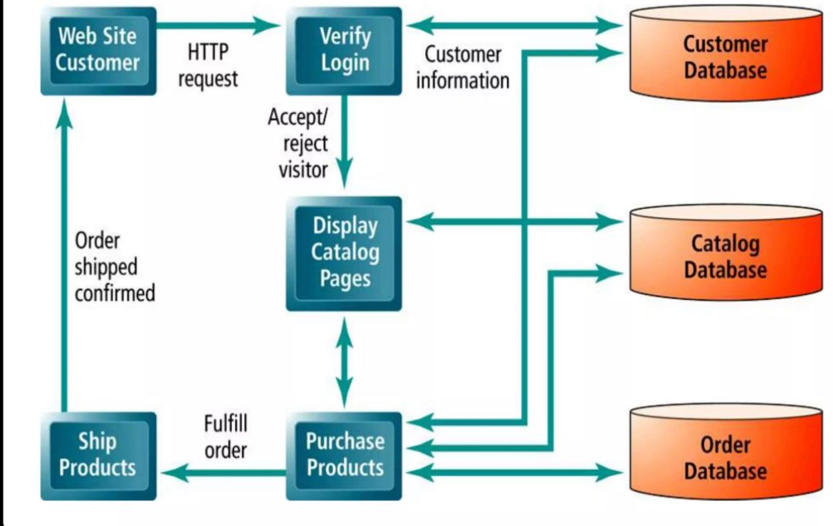

Slide 13
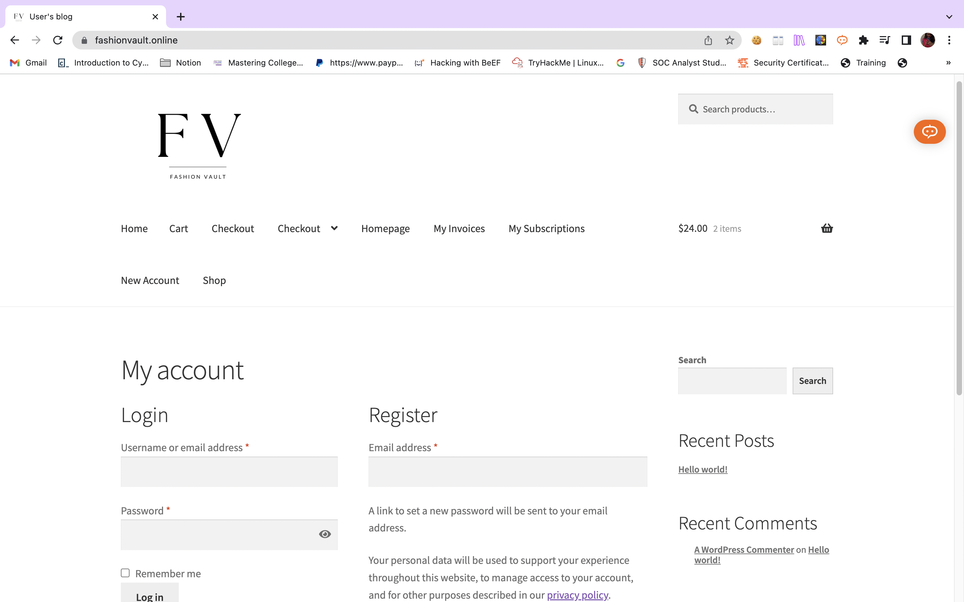

Slide 14
THE ABOVE E-COMMERCE WEBSITE BUILT USING
MICROSOFT AZURE PLATFORM
WORDPRESS
PAYMENT AND SECURITY PLUGINS

Slide 16
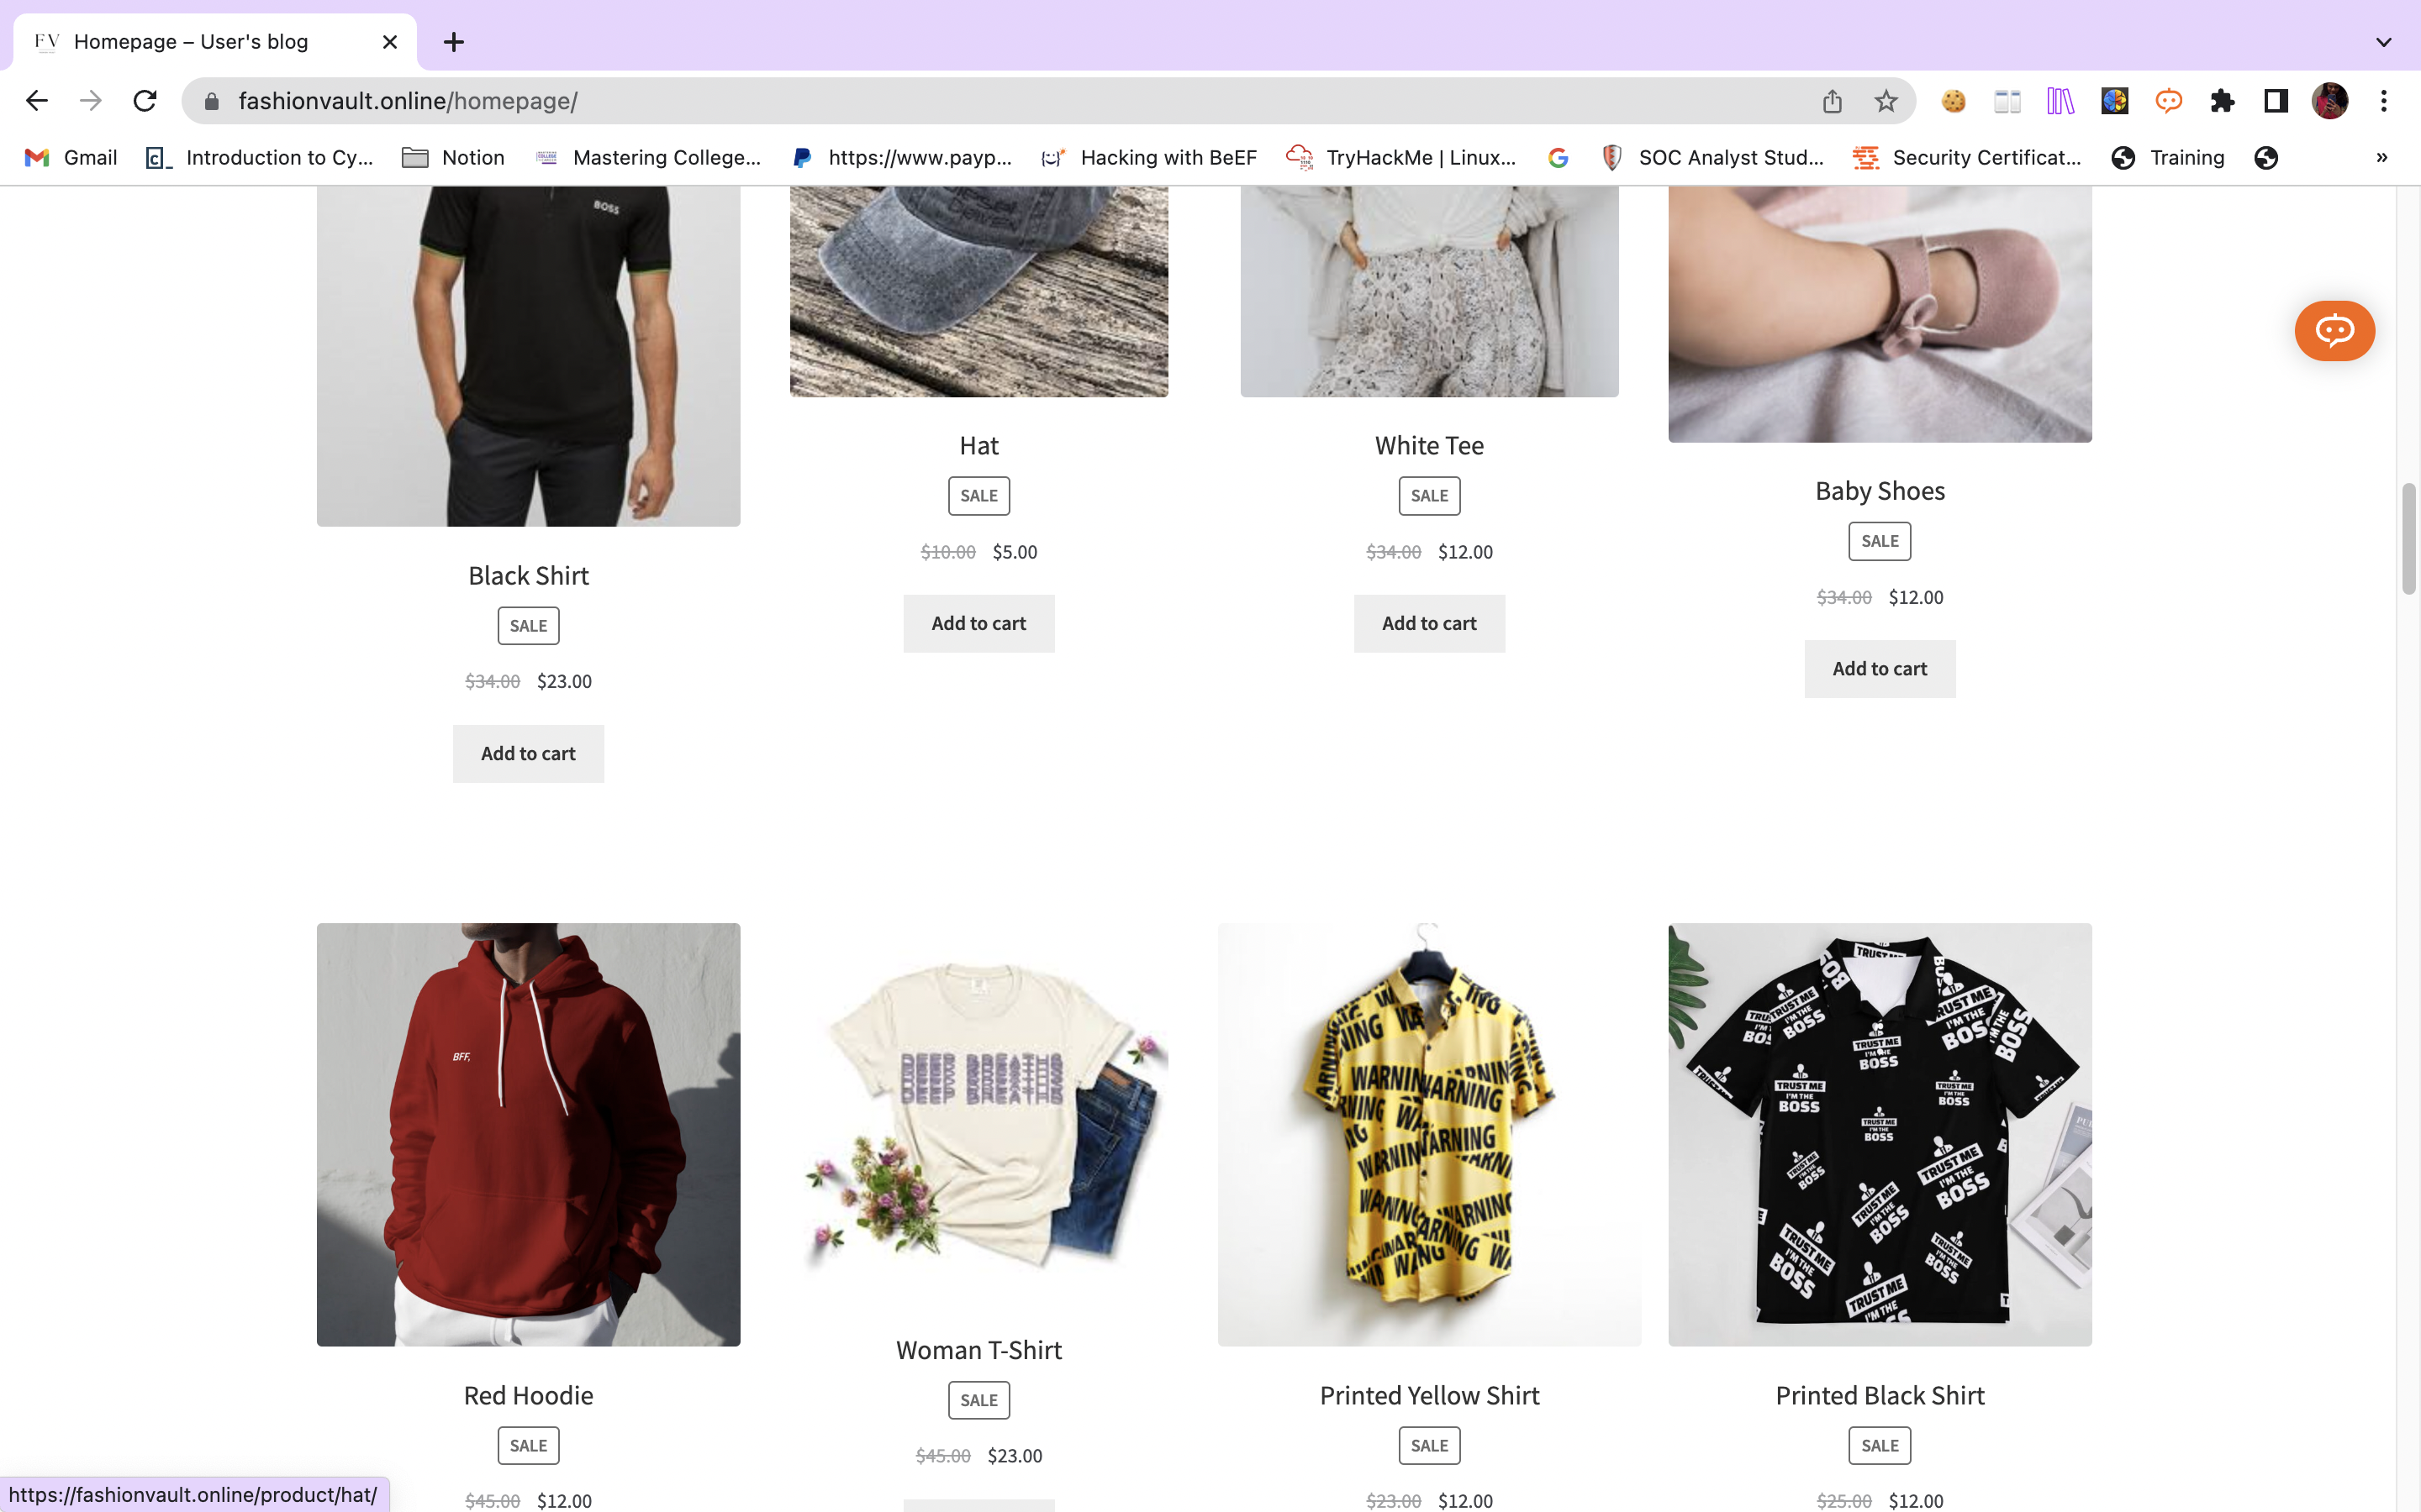

Slide 17
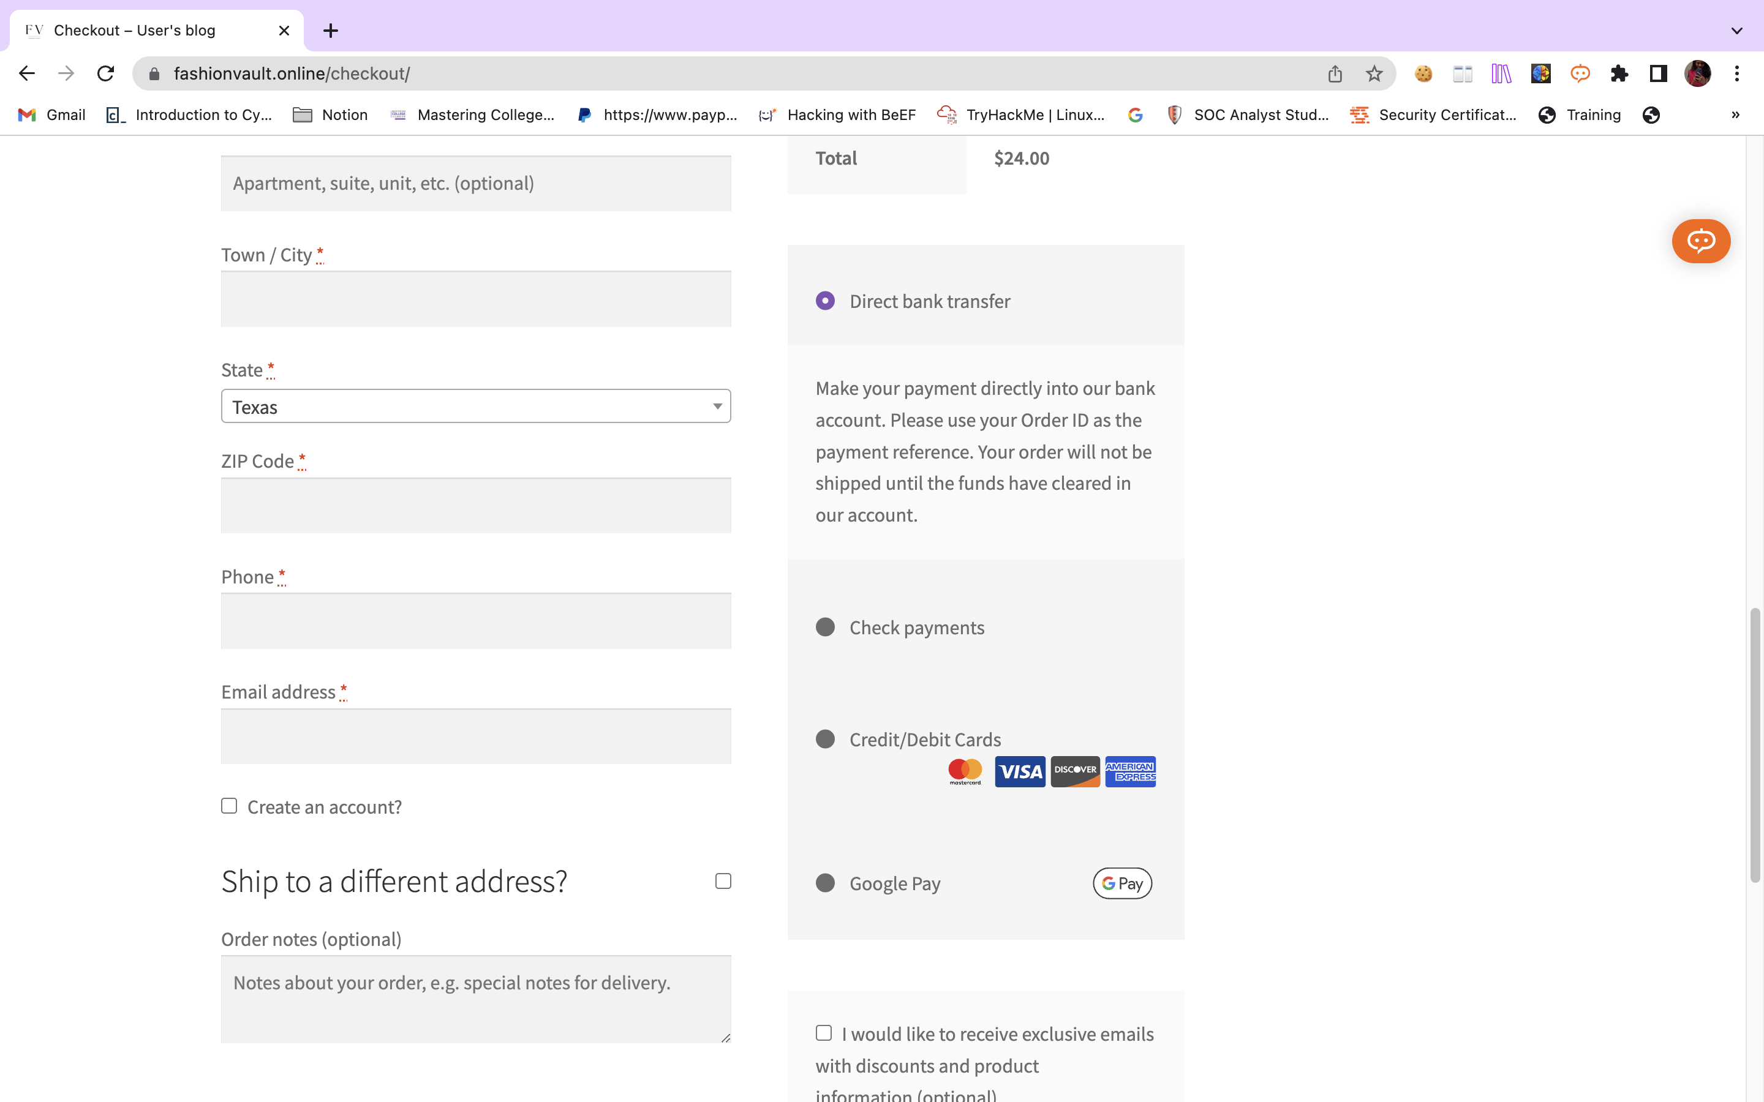

Slide 18
MAJOR ATTACKS
SQL INJECTION
CROSS SITE SCRIPTING
DDOS Attacks

Slide 19
Sql injection
This is a web security vulnerability that allows an attacker to interfere with the queries that an application makes to its database.
is a serious threat to the confidentiality of data in e-commerce. It allows an attacker to interfere with the queries that an application makes to its database, granting them access to view data that they normally cannot retrieve.
This includes sensitive data that belongs to other users, as well as any data within the application itself. The consequences of this vulnerability can be devastating for both the e-commerce business and its customers
SOME SQL INJECTIONS
1.RETRIEVING HIDDEN DATA: MODIFYING AN SQL QUERY TO GET ADDITIONAL INFORMATION.
2.SUBVERTING APPLICATION LOGIC: CAN MODIFY A QUERY TO INTERFERE WITH THE APPLICATION'S LOGIC
3.UNION ATTACKS:FOR RETRIEVING DATA FROM DIFFERENT DATABASE TABLES
4.EXAMINING THE DATABASE:TO GET THE INFORMATION ABOUT THE STRUCTURE AND VERSION OF THE DATABASE

Slide 20
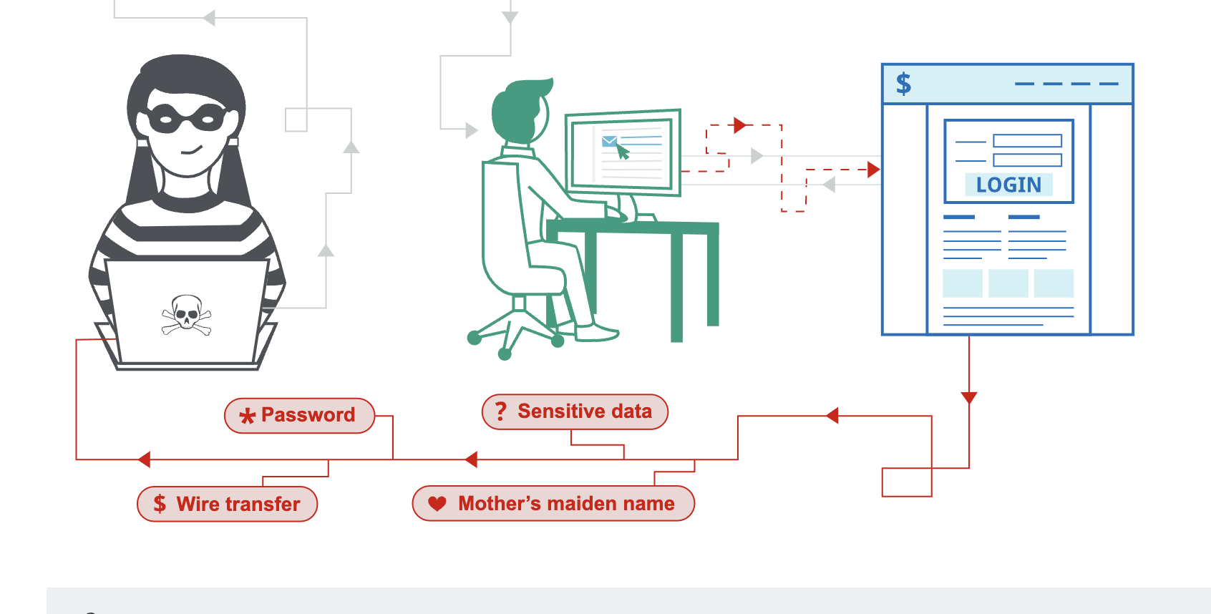
CROSS SITE SCRIPTING
CROSS-SITE SCRIPTING WORKS BY MANIPULATING A VULNERABLE WEB SITE SO THAT IT RETURNS MALICIOUS JAVASCRIPT TO USERS. WHEN THE MALICIOUS CODE EXECUTES INSIDE A VICTIM'S BROWSER, THE ATTACKER CAN FULLY COMPROMISE THEIR INTERACTION WITH THE APPLICATION
cross-origin iframes are prevented from calling alert() in chrome

Slide 21
DDOS Attacks
What does ddos mean?
DDoS Attack means "Distributed Denial-of-Service (DDoS) Attack
What happens in DDOS?
the attacker floods a server with internet traffic to prevent users from accessing
connected online services and sites.
A DDoS attack aims to overwhelm the devices, services, and network of its intended target with
fake internet traffic, rendering them inaccessible or useless to legitimate users.

Slide 22
Different types DDOS
APPLICATION LAYER DDOS ATTACK
PROTOCOL Ddos Attack
THE ATTACKER TARGET HTTP TRAFFIC. THEY OFTEN USE AN ATTACK CALLED HTTP FLOOD, WHERE THEY SEND LOTS AND LOTS OF HTTP REQUESTS AT ONCE. IT'S LIKE HITTING YOUR BROWSER'S REFRESH BUTTON THOUSANDS OF TIMES, BUT WITH LOTS OF OTHER PEOPLE DOING THE SAME THING AT THE SAME TIME.
EXAMPLE:SYN FLOOD ATTACK,
WHEN MAKING AN INTERNET REQUEST, THREE THINGS HAPPEN: A REQUEST FOR DATA (SYN), A RESPONSE TO THE DATA REQUEST (ACK), AND A CONFIRMATION THAT THE DATA HAS ARRIVED (SYN-ACK). THE SYN FLOOD ATTACK OVERWHELMS THE SYSTEM WITH FAKE SYN PACKETS FROM FAKE IP ADDRESSES, CAUSING A DENIAL OF SERVICE.

Slide 23
DIFFERENT TYPES DDOS
(contd)
DNS AMPLIFICATION ATTACK
THESE ATTACKS EXPLOIT OPEN DNS SERVERS' VULNERABILITY TO SEND A LARGE AMOUNT OF TRAFFIC TO THE TARGET SERVER. THE RESULT IS THAT THE SERVER GETS OVERWHELMED AND CANNOT RESPOND TO LEGITIMATE REQUESTS. ONCE THE ATTACKER SUCCESSFULLY WEAKENS THE TARGET SERVER, THEY CAN LAUNCH MORE ATTACKS AND GAIN ACCESS TO SENSITIVE DATA

Slide 24
Methods to Ensure Website Security
KEEP YOUR WORDPRESS CORE, THEMES, AND PLUGINS UP TO DATE
LIMIT LOGIN ATTEMPTS
USE STRONG AND UNIQUE PASSWORDS
REGULARLY BACKUP YOUR WEBSITE
IMPLEMENT TWO-FACTOR AUTHENTICATION (2FA)/MFA
USE A SECURE WEB HOSTING PROVIDER

Slide 25
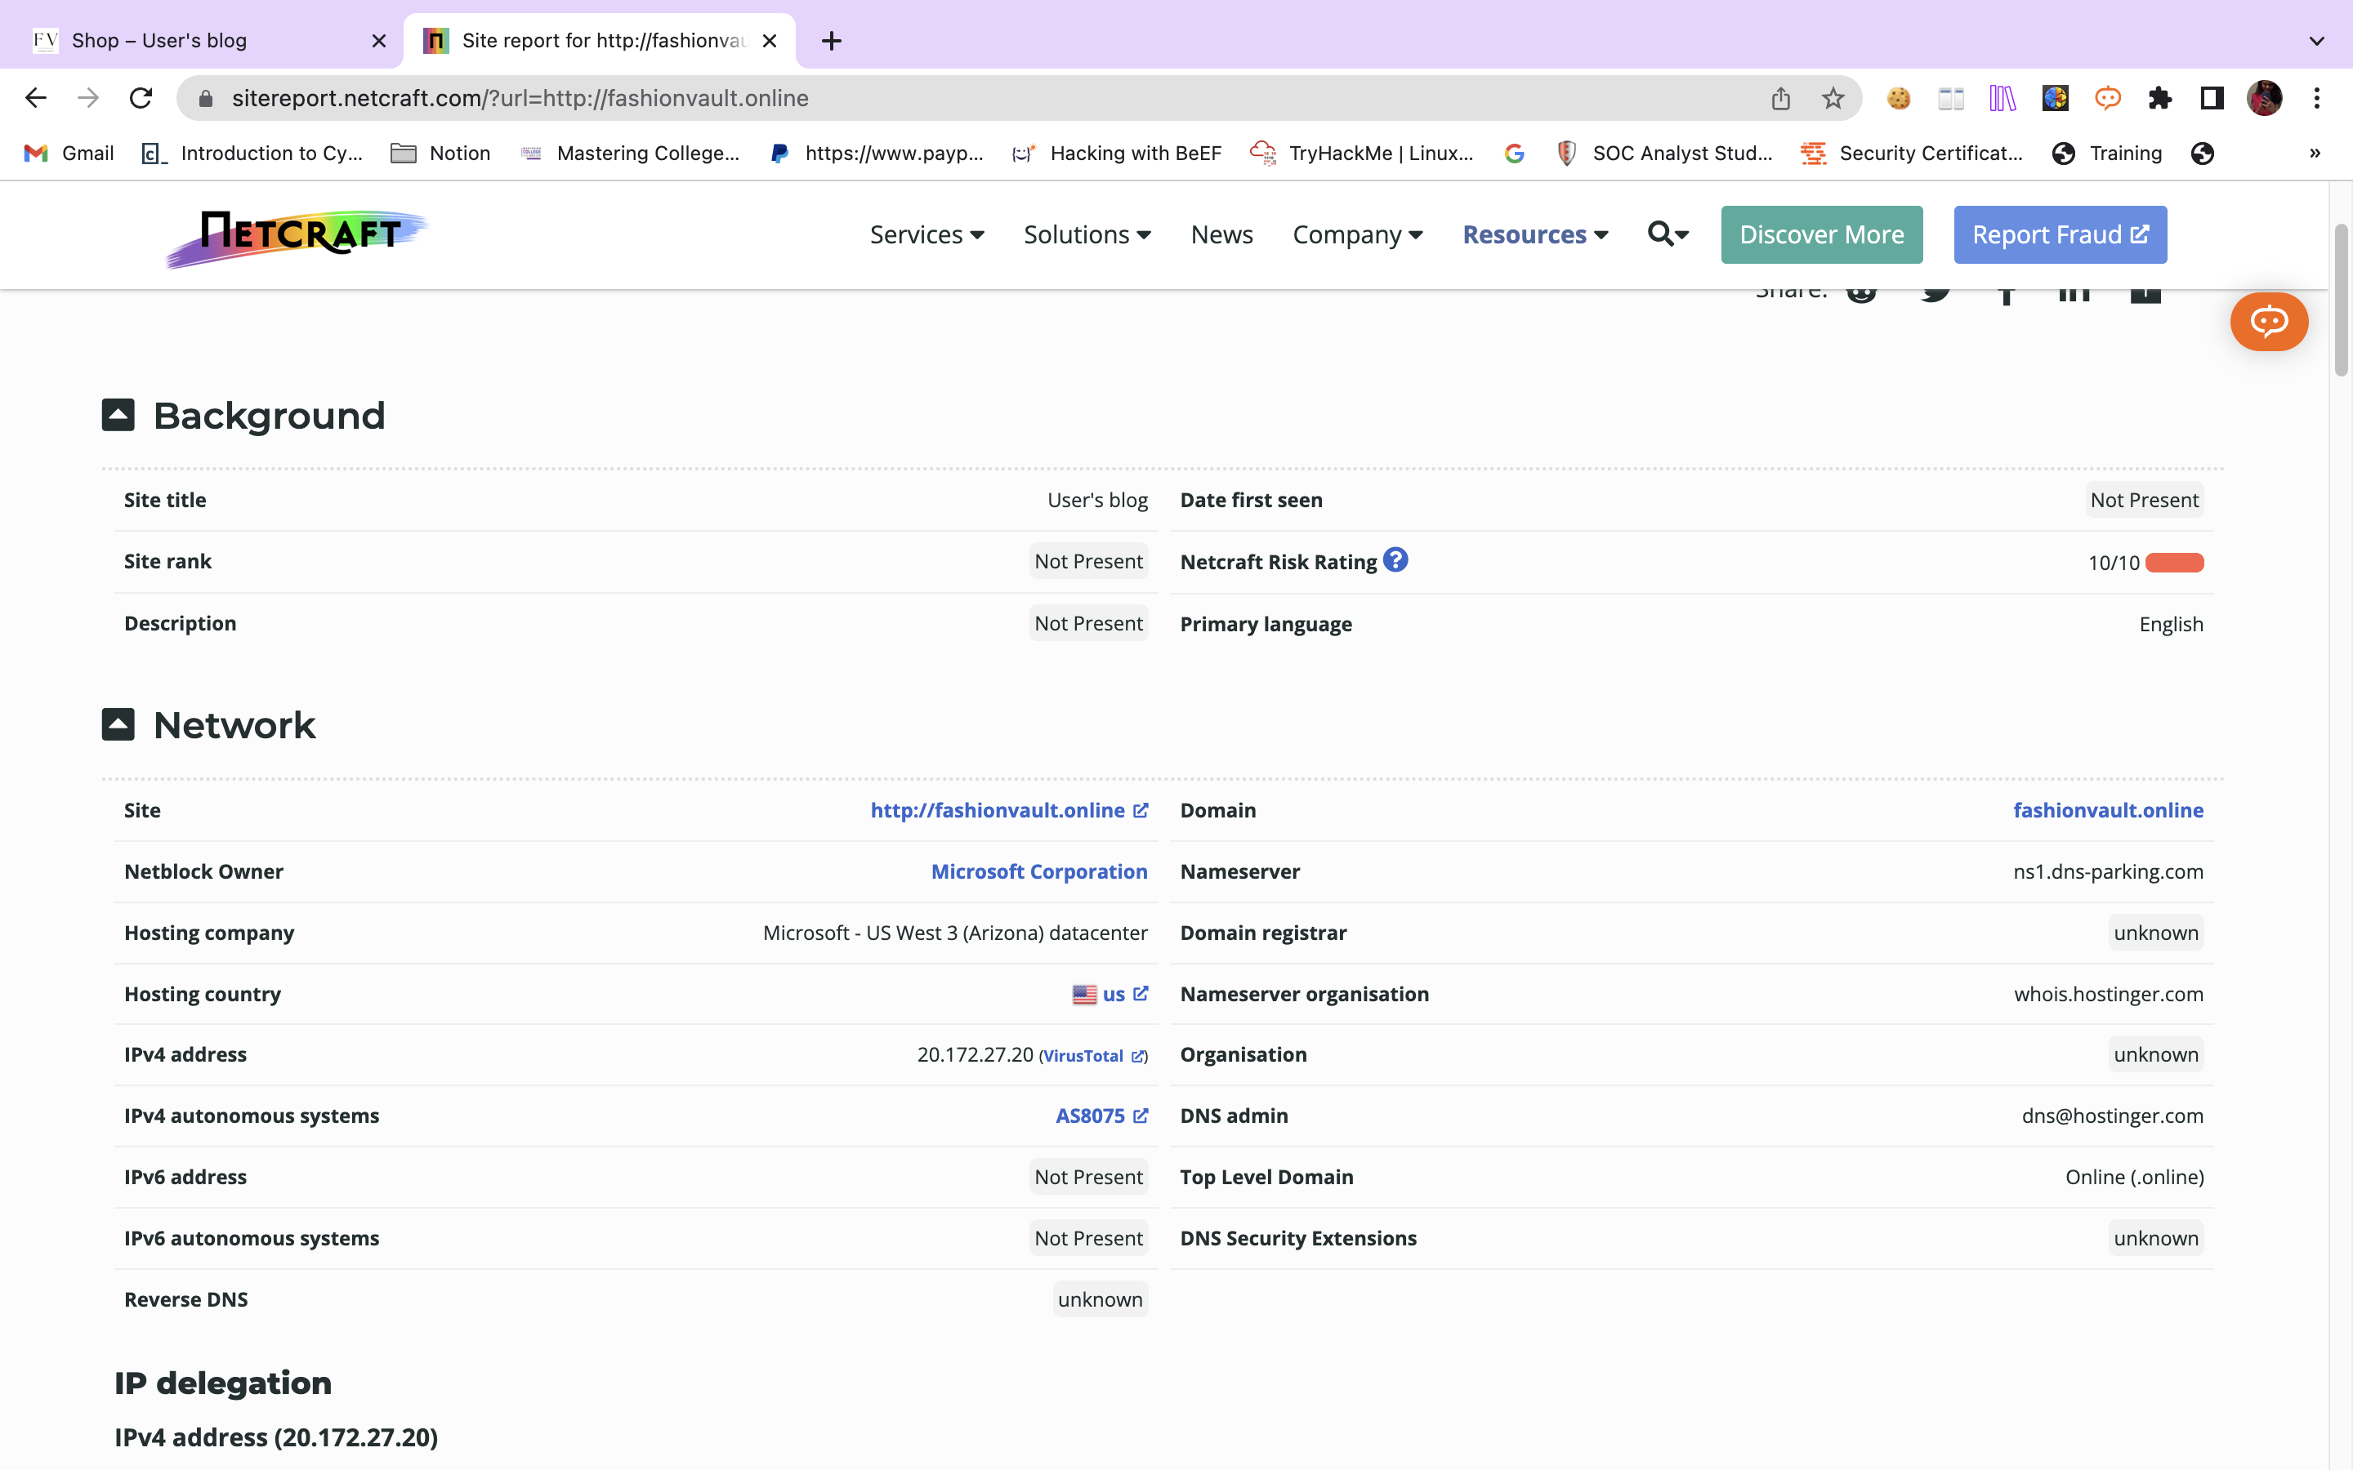
Site report

Slide 26
Vulnerability Scan
OPENVAS SCAN:
A SYSTEM DESIGNED FOR VULNERABILITY ASSESSMENT CAPABLE OF IDENTIFYING SECURITY PROBLEMS IN VARIOUS TYPES OF SERVERS AND NETWORK EQUIPMENT.
OWASP ZAP:
open-source web application security testing tool FOR ,TO identify and fix security vulnerabilities in web applications during the development and testing stages
NMAP:
Nmap is not a dedicated vulnerability scanner, and while it can be a valuable tool in a vulnerability assessment,can identify open ports, services running on those ports, operating systems, and network topology

Slide 27
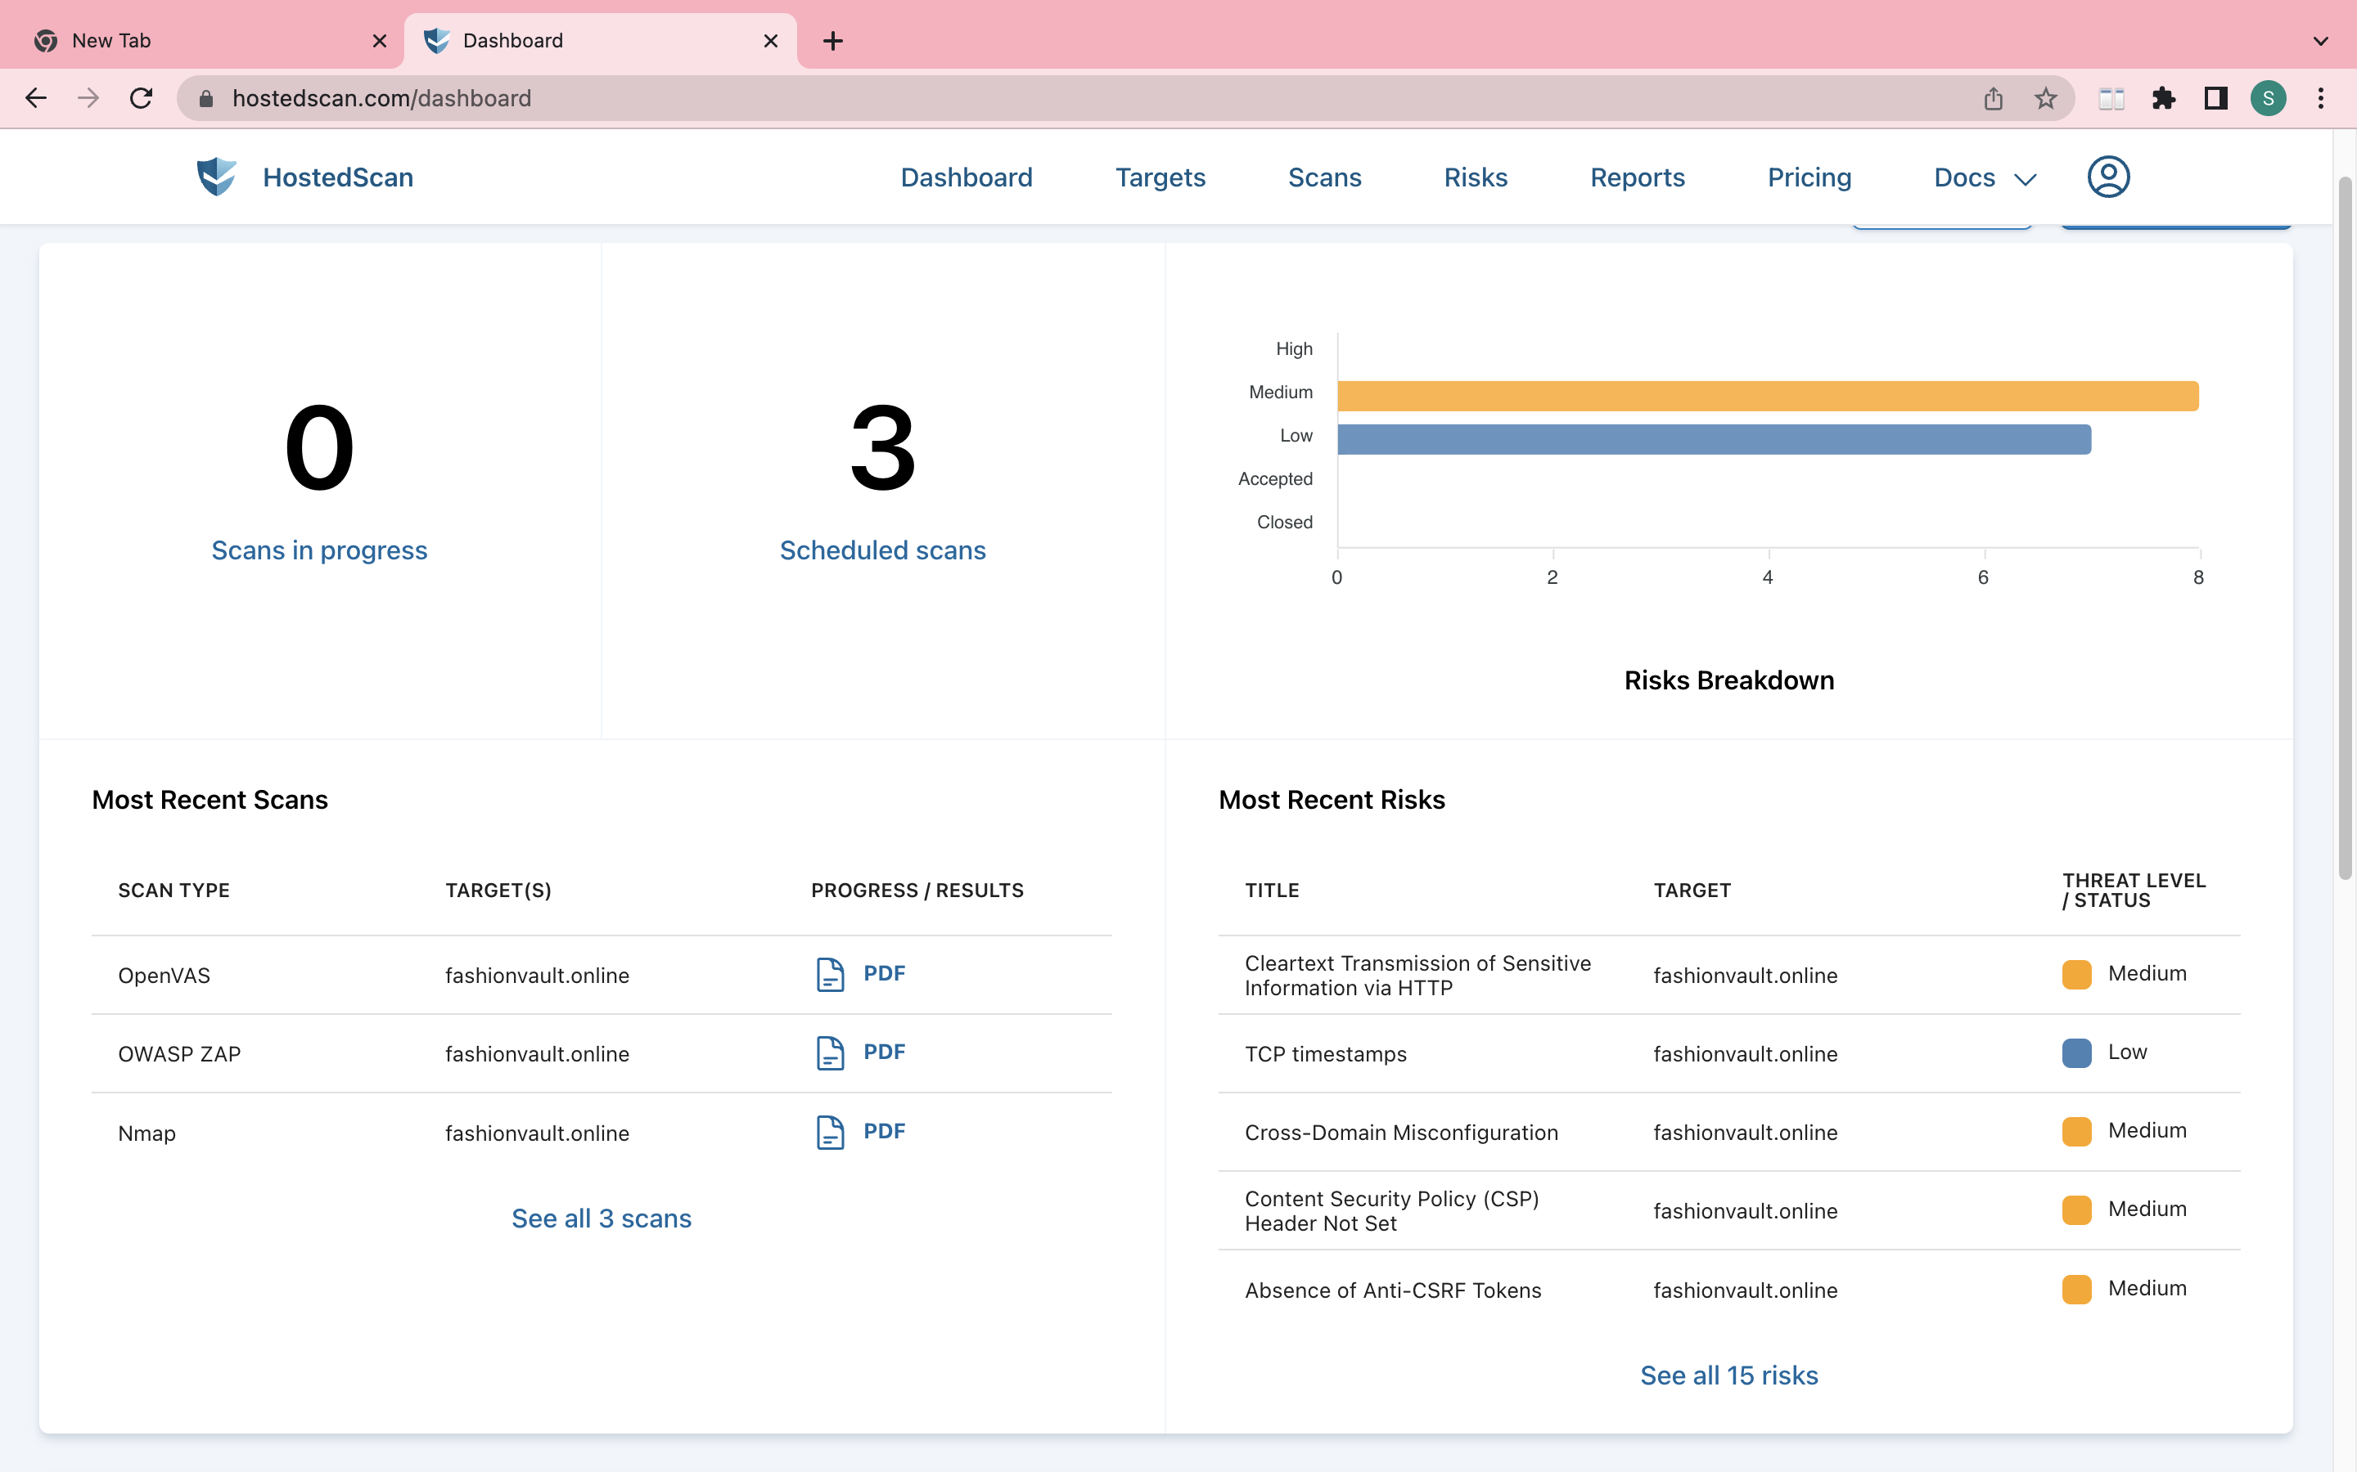

Slide 28
SECURITY PLUGINS
WP SECURITY PLUGIN
SSL CERTIFICATE
LIMITED LOGIN ATTEMPTS
2FA

Slide 29
THANK YOU

